Slide 1
AlexNet
AlexNet, developed by Alex Krizhevsky and his colleagues in 2012, was a groundbreaking convolutional neural network (CNN) that significantly advanced the field of computer vision.
AlexNet achieved state-of-the-art performance in the 2012 ImageNet Large Scale Visual Recognition Challenge (ILSVRC), significantly outperforming the competition.
Its success demonstrated the power of deep learning in image classification tasks and spurred further research and development in convolutional neural networks.
Overall, AlexNet's architecture and techniques laid the groundwork for many subsequent deep learning models, paving the way for advances in various applications, including image and video recognition, object detection, and more.

Slide 2
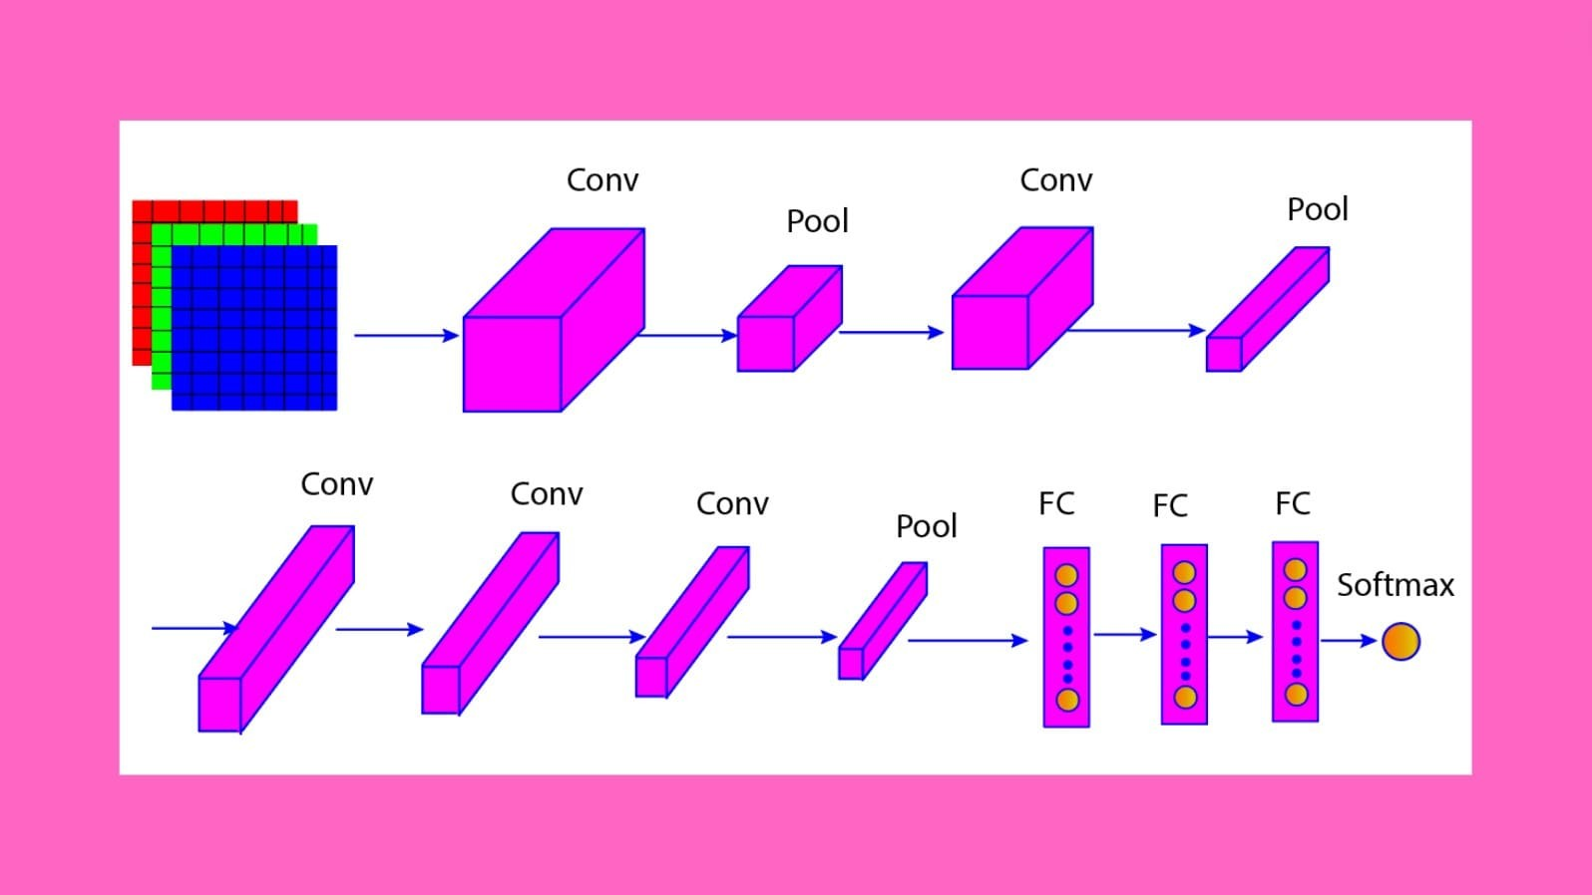
AlexNet

Slide 3
AlexNet Architecture
1. Input Layer:
Input Size: 227x227 pixels (originally designed to accept 224x224, but the extra padding was added for compatibility). Each image has three color channels (RGB).
2. Convolutional Layers:
Conv Layer 1:
Filters: 96
Kernel Size: 11x11
Stride: 4
Activation: ReLU (Rectified Linear Unit)
Output Size: 55x55x96 (after applying padding and the convolution operation)
Pooling Layer 1:
- Type: Max Pooling
- Kernel Size: 3x3
- Stride: 2
- Output Size: 27x27x96

Slide 4
AlexNet Architecture
Conv Layer 2:
- Filters: 256
- Kernel Size: 5x5
- Stride: 1
- Activation: ReLU
- Output Size: 27x27x256 (after padding)
Pooling Layer 2:
- Type: Max Pooling
- Kernel Size: 3x3
- Stride: 2
- Output Size: 13x13x256

Slide 5
AlexNet Architecture
Conv Layer 3:
- Filters: 384
- Kernel Size: 3x3
- Stride: 1
- Activation: ReLU
- Output Size: 13x13x384
Conv Layer 4:
- Filters: 384
- Kernel Size: 3x3
- Stride: 1
- Activation: ReLU
- Output Size: 13x13x384

Slide 6
AlexNet Architecture
Conv Layer 5:
- Filters: 256
- Kernel Size: 3x3
- Stride: 1
- Activation: ReLU
- Output Size: 13x13x256
Pooling Layer 3:
- Type: Max Pooling
- Kernel Size: 3x3
- Stride: 2
- Output Size: 6x6x256

Slide 7
AlexNet Architecture
3. Fully Connected Layers:
FC Layer 1:
Neurons: 4096
Activation: ReLU
Dropout: 50% dropout rate during training for regularization
FC Layer 2:
Neurons: 4096
Activation: ReLU
Dropout: 50% dropout rate during training for regularization
FC Layer 3:
Neurons: 1000 (for 1000 classes in the ImageNet dataset)
Activation: Softmax (to produce class probabilities)

Slide 8
Thank You

